Slide 1
Wi-Fi Indoor Positioning System
電機四 許元譯
電機四 紀彥仰

Slide 2
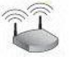
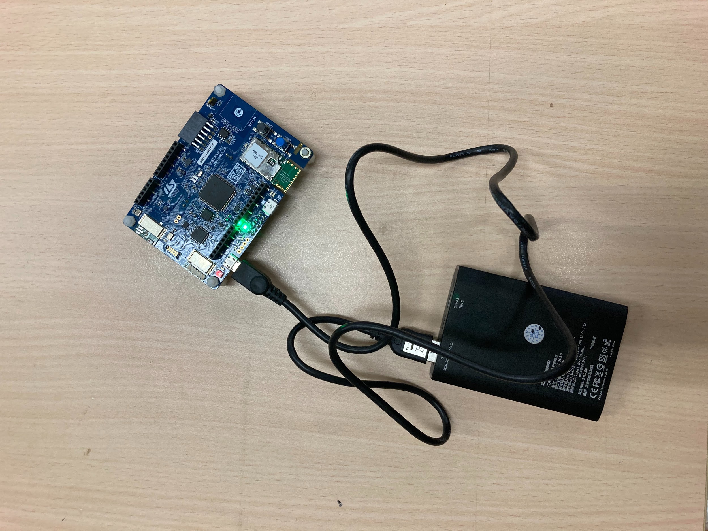
Framework
DNN model
Location
Wi-Fi Qualities

Slide 3
How to obtain the DNN model
Collect labeled data
Preprocess data
Data augmentation
Train the DNN model

Slide 4
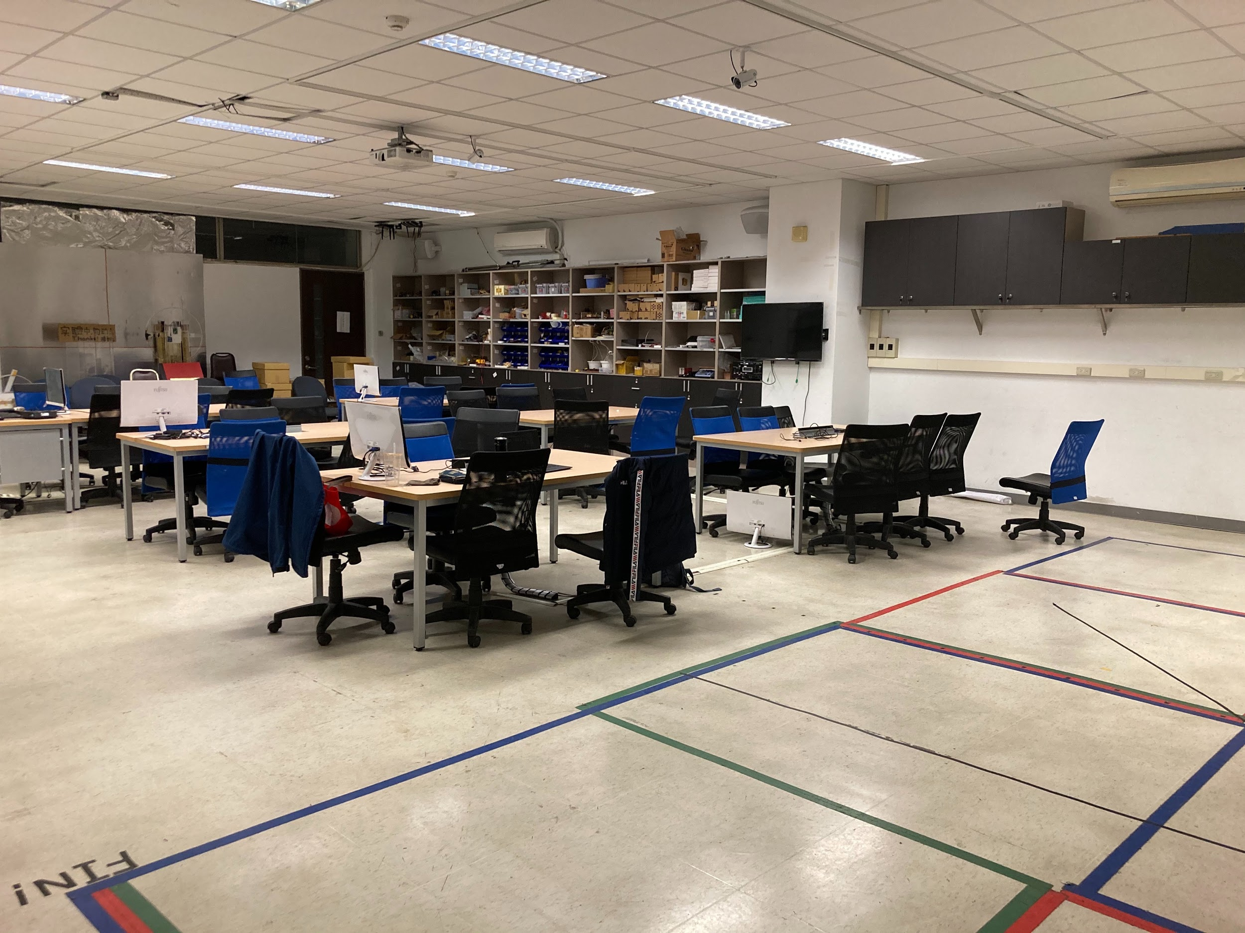
Collect labeled data
10 x 6 grid points in MD402
Grid size: 120cm x 120cm
Scan Wi-Fi qualities in each grid point

Slide 5
Preprocess data
Choose the N most common Wi-Fi address
Transform all data into N-dimension vectors
We choose N = 64

Slide 6
Data Augmentation
Random noise
Random drop

Slide 7


Train the DNN model
N
128
Feature Extractor
Regression
$$\hat{x},\hat{y}$$
Mean square error loss
$$x,y$$

Slide 8
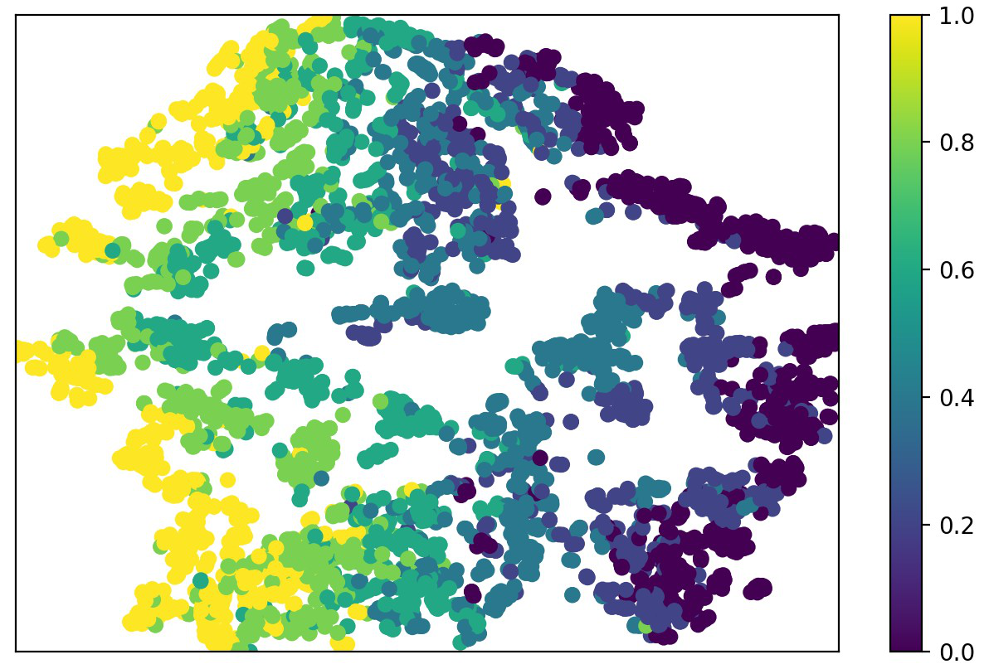
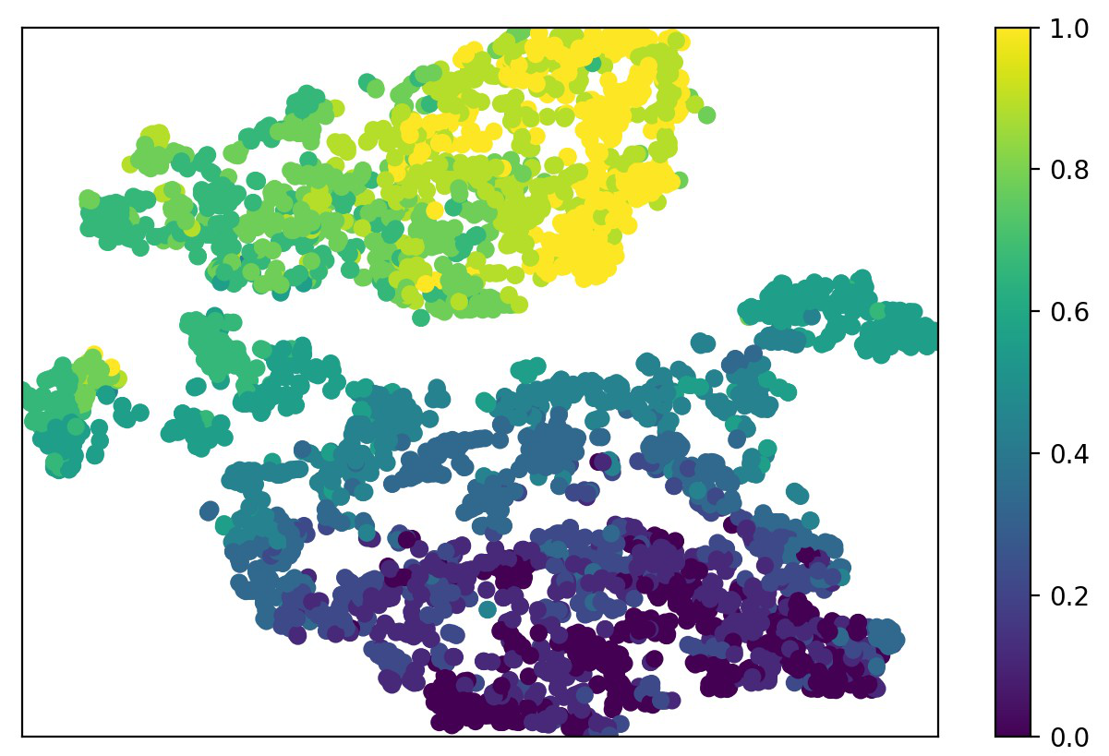
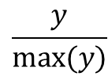
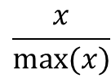
Feature Space tSNE Visualization
$$\frac{x}{max⁡(x)}$$
$$\frac{y}{max⁡(y)}$$

Slide 9
Experiments
Training data: 80%
Validating data: 20%
Error: Mean L2-distance with ground truth
N | Error(cm)
128 | 18.4
64 | 14.2
32 | 127.7

Slide 10
Experiments
A: data collected on date A
B: data collected on date B
Pretrain | Train | Valid | Error(cm)
 | B | 90% A | 528
 | 10% A | 90% A | 180
B | 10% A | 90% A | 120

Slide 11
Conclusion
Performance may drop due to changing of Wi-Fi environment.
Fine-tuning with small volumes of new data is able to boost the performance in new Wi-Fi environment.

Slide 12
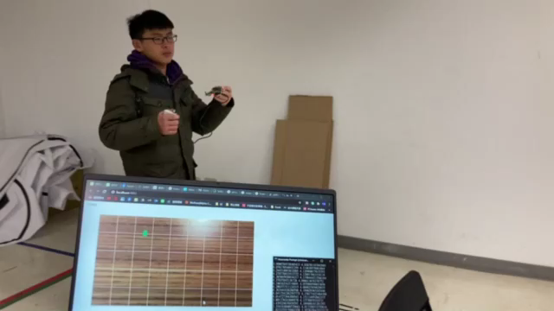
Demo

